Slide 1
Data Governance Council Meeting
August 21, 2025
Virginia Office of Data Governance and Analytics

Slide 2
Agenda
Agenda item | Facilitator | Content
1:00 PM: Order of Business | Marcus Thornton (ODGA) | Welcome, Roll Call, Objectives of Meeting, etc
1:10 PM: ODGA Updates | Marcus Thornton, Jessi Bailey, Chris Burroughs (ODGA) | Data Governance Award Winners, Open Data Portal, Data Governance, and more
1:20 PM: Streamline your Data Governance: Automating Metadata with AP and API’s | Shwetha Tadimalla and Atiq Rahaman (ODGA) | Updates in ODGA’s instance of Microsoft Purview
1:40 PM: Government Data Collection and Dissemination Practices Act Update | Chris Burroughs (ODGA) | Updates on ODGA progress of agency compliance for the act
1:55 PM: Break | Break | Break
2:05 PM: Project Update: Substance Use Disorder Abatement | Guest Speaker from Deloitte | Information about the project
2:10 PM: ODGA Events | Jessi Bailey (ODGA) | Upcoming Events
2:20 PM: Public and Member Comment. Meeting Adjournment | Marcus Thornton (ODGA) | N/A

Slide 3
Data Governance Council
Liaise between state agency operations and the CDO
Review open data assets prior to publication.
Provide to the Board any reports on the Council's recommendations and work as required by the Board.
Develop necessary privacy and ethical standards and policies for Commonwealth Data Trust resources.
Monitor the sharing of Commonwealth Data Trust member-contributed data resources.
Review and approve new Commonwealth Data Trust-managed data resources.
Conduct any other business the CDO deems necessary for Commonwealth Data Trust governance.
Related legislation: https://lis.virginia.gov/cgi-bin/legp604.exe?212+ful+CHAP0314
Purpose
Advise the CDO on data technology, policy, and governance structure.
Administer data governance policies, standards, and best practices, as set by the Board.
Oversee data sharing and analytics projects.

Slide 4
Meeting Purpose
Mature agency data governance
Highlight value of cross-agency data sharing
Launch data classification efforts
Improve GDCDPA awareness

Slide 5

Order of Business
Approve Meeting Minutes

Slide 6
Data Governance Award Winners
Large Agency
Medium Agency
DBHDS
VSP
TAX
DOE
TRS
Honorable Mention
DEQ and VDH

Slide 7
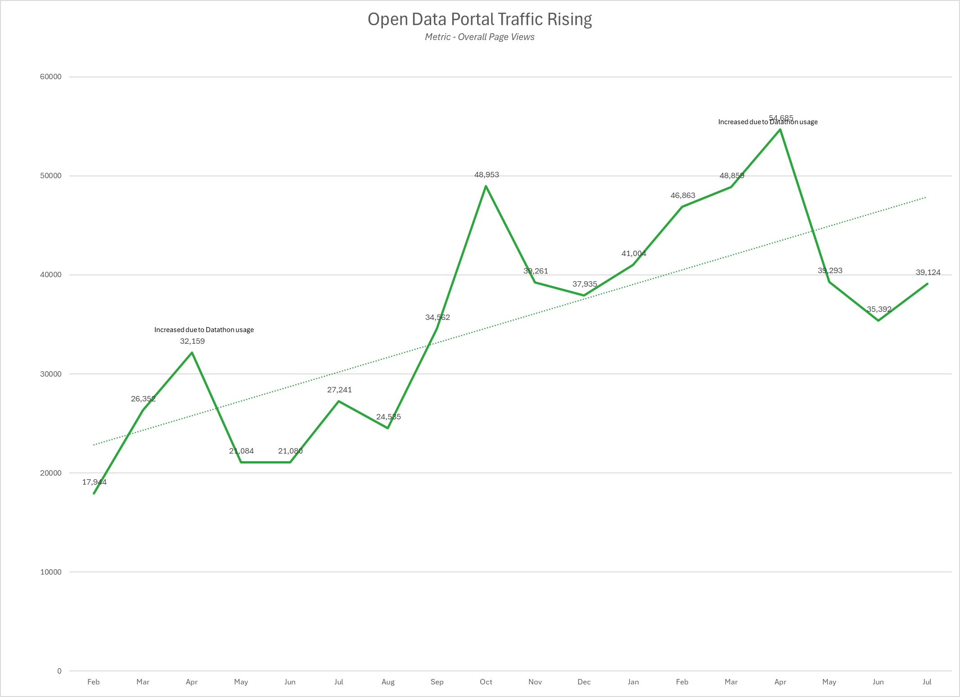
Open Data Portal Continues to Grow
19,855 datasets in August 2025 vs 14,410 in April 2025
  38% increase in 5 months
#1 Open Data Portal in US based on total datasets

Slide 8
Data Classification
Sec 540 Released
ODGA Data Classification Policy and Standard developed
Data Classification Framework in progress

Slide 9
Streamline your data governance
Automating Metadata with AI and APIs

Slide 10


Before vs After
2 hours per table
Manual effort
5 minutes
Automated
This Photo by Unknown Author is licensed under CC BY-NC-ND
This Photo by Unknown Author is licensed under CC BY-ND

Slide 11
Learning Language Model (LLM) Prompts
Task | Prompt
Data Dictionary Generation | Create a comprehensive data dictionary for the following dataset columns: [column list]. For each column, provide: field name, data type, description, business rules, valid values/ranges, data source, and any dependencies. Format as a structured table.
Metadata Quality Assessment | Analyze this metadata catalog and identify: missing descriptions, inconsistent naming conventions, incomplete lineage information, and outdated documentation. Provide a prioritized remediation plan with specific recommendations.
Business Glossary Creation | Generate business term definitions for this domain: [domain]. Include: term name, definition, business context, related terms, data steward, and usage examples. Ensure definitions are accessible to non-technical stakeholders.
Data Classification | Classify this dataset according to our data sensitivity levels: [provide classification framework]. For each field, assign: sensitivity level, regulatory requirements (GDPR, CCPA, etc.), retention period, and access controls needed.

Slide 12
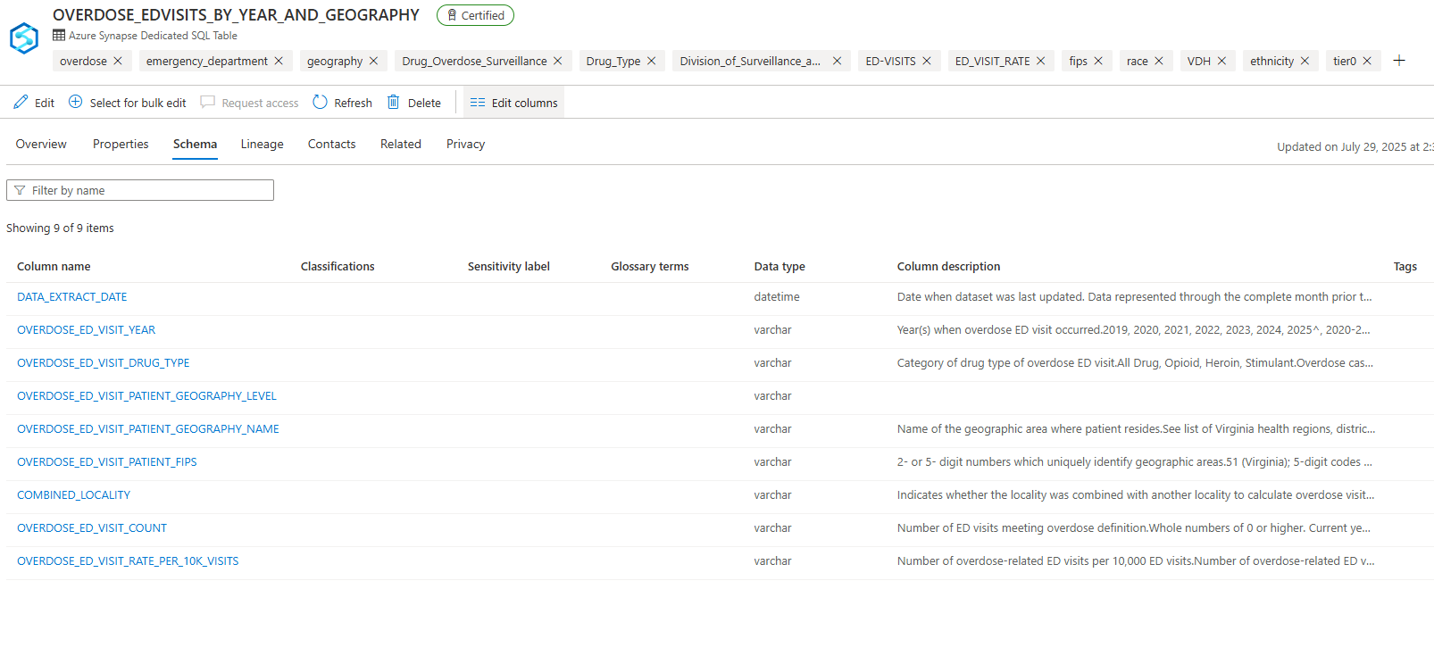
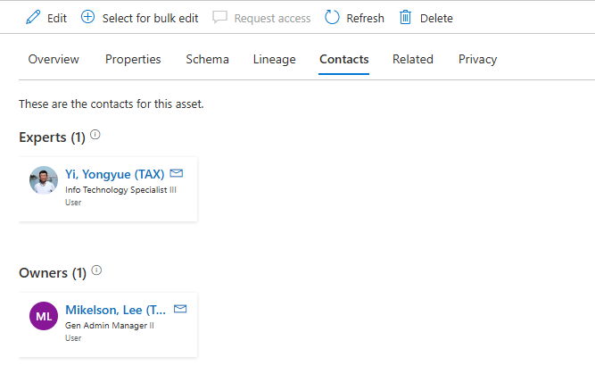
Example of metadata update using API

Slide 13
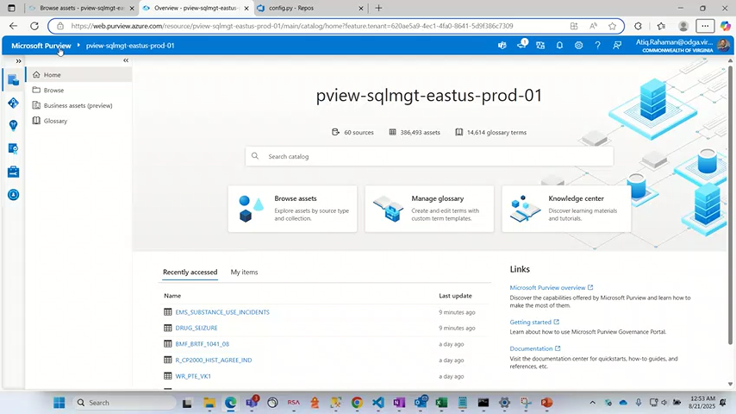
Manual Update of metadata and import option

Slide 14
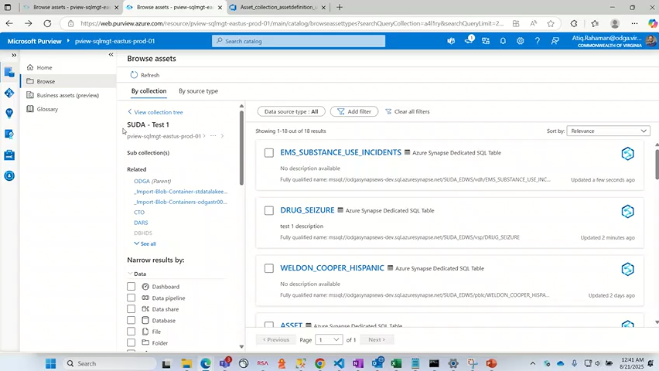
Demo-Update description

Slide 15

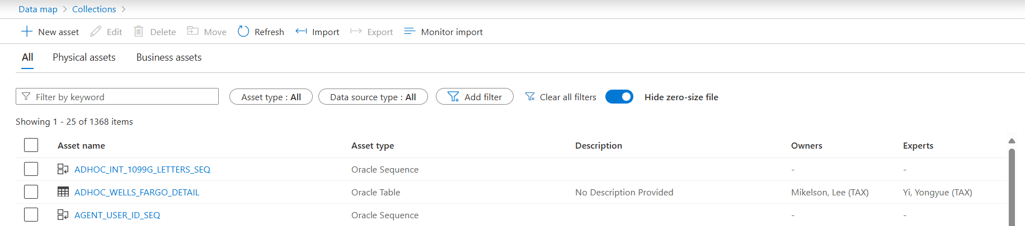
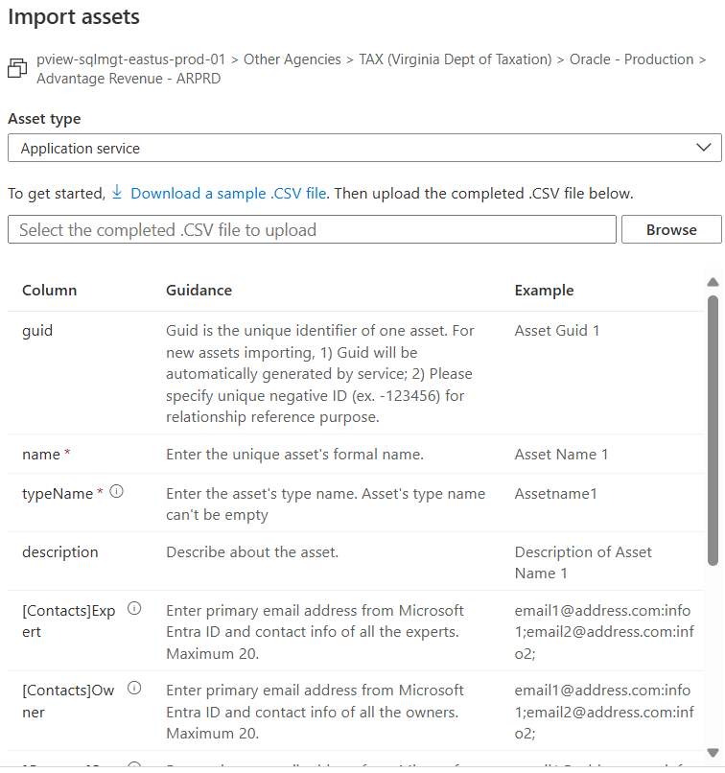
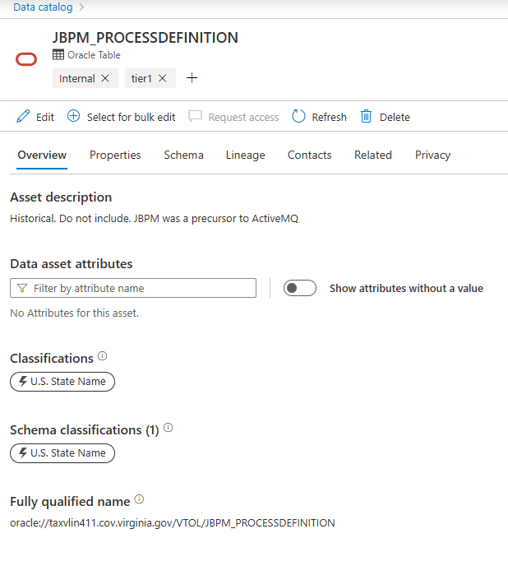
Bulk upload limitations and APIs in rescue

Slide 16
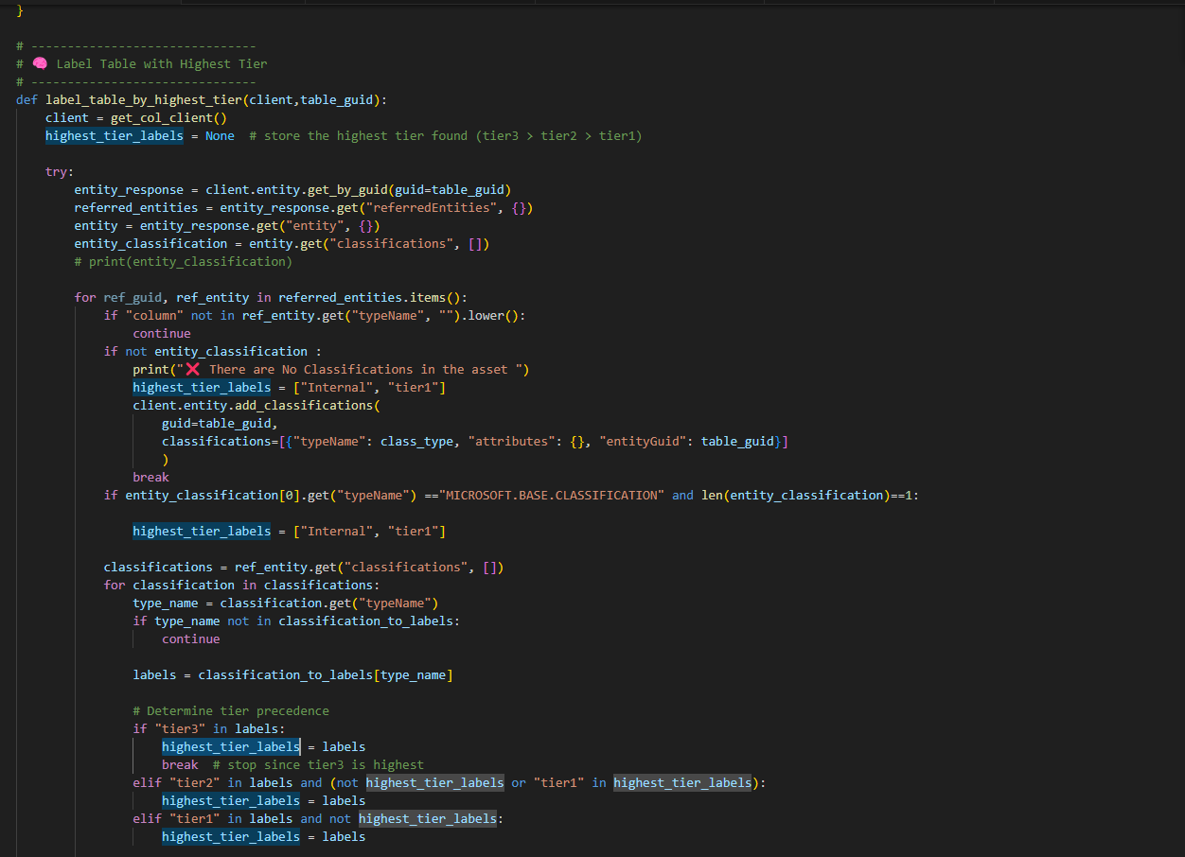
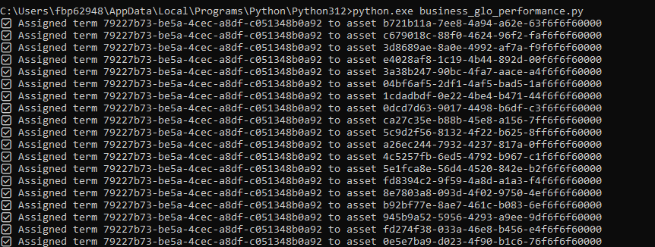
API examples

Slide 17
Virginia Government Data Collection and Dissemination Practices Act
GDCDPA

Slide 18

What is the GDCDPA?
The Government Data Collection and Dissemination Practices Act (Code of Virginia § 2.2-3800 et seq.) is Virginia's comprehensive privacy law governing how state and local agencies handle personal information.
Why is ODGA offering this training?
§ 2.2-203.2:4 “The purpose of the Office shall be to (i) improve compliance with the Government Data Collection and Dissemination Practices Act (§ 2.2-3800 et seq.)”
Notes:
Why Does This Matter?
Sarah works for a state agency and receives a phone call asking for an employee's home address. Without knowing the GDCDPA, she might accidentally violate privacy laws. After this training, she'll know the proper procedures to follow.

Slide 19
🔓 Generally Permissible Sharing
Within agency
Between agencies
Statistical purposes
FOIA compliance
Legal requirements
For routine administrative purposes
When necessary for the receiving agency's official duties
When individual identities are removed
Information subject to public disclosure
Court orders, subpoenas, or other legal mandates

Slide 20
Collection and Sharing is Allowed for “Proper Purpose”
Streamline administrative processes to improve the efficiency and efficacy of services, access to services, eligibility determinations for services, and service delivery
Reduce paperwork and administrative burdens on applicants for and recipients of public services
Improve the efficiency and efficacy of the management of public programs
Prevent fraud and improve auditing capabilities
Conduct outcomes-related research
Develop quantifiable data to aid in policy development and decision making to promote the most efficient and effective use of resources
Perform data analytics regarding any of the purposes set forth in this definition.

Slide 21
⚠️ Prohibited Disclosures
Not directly related to the receiving party's official duties
Would violate the individual's reasonable expectation of privacy
Prohibited by other laws or regulations
For commercial or non-governmental purposes
Without proper authorization or legal basis

Slide 22

Web Privacy Policy Required
“ Every public body, as defined in § 2.2-3701, that has an Internet website associated with that public body shall develop an Internet privacy policy and an Internet privacy policy statement that explains the policy to the public.
The policy shall be consistent with the requirements of this chapter. The statement shall be made available on the public body's website in a conspicuous manner.”
VITA can provide a privacy policy template

Slide 23
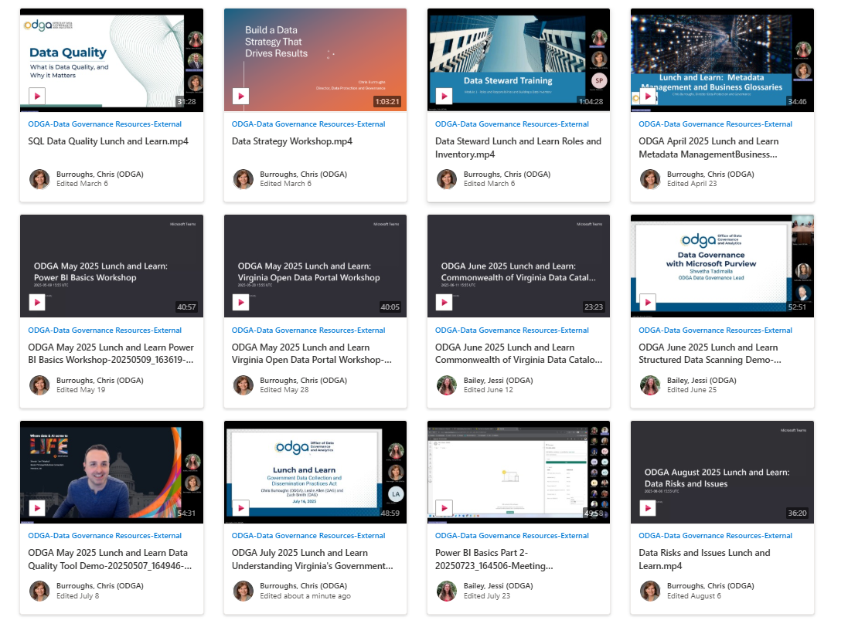
ODGA July 2025 Lunch and Learn Understanding Virginia's Government Data Collection and Dissemination Practices Act-20250716_164543-Meeting Recording.mp4
NEWS
New Data Literacy Video
  Per Capita
Data Literacy videos will be uploaded to COVLC in September
Next Virginia Data Collection and Dissemination Practices Act Lunch and Learn: October 8th
Notes:
Mention per capita video

Slide 24
Project Showcase

Slide 25
Substance Use Disorder Abatement (SUDA) Demo

Slide 26
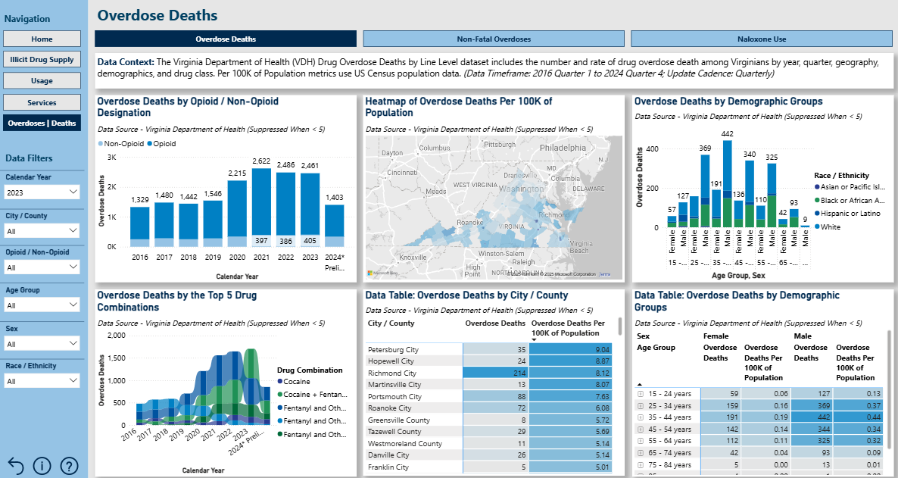
Substance Use Disorder Abatement (SUDA) Analytics Platform
Accelerating Virginia’s fight against the opioid and substance use crisis.
Understand the nature and impacts of the crisis
Respond rapidly with up-to-date information
Enhance stakeholder collaboration and information sharing
Measure real-time outcomes of interventions
Streamline development of data driven grant proposals
Notes:
For over a decade, the Commonwealth of Virginia has been working to combat the opioid and substance use crisis and its impact on families and communities, as well as additional pressure on law enforcement, hospitals, and other local resources. The SUDA platform is a tool that brings together data from multiple state agencies to support the Commonwealth’s efforts to:

Slide 27


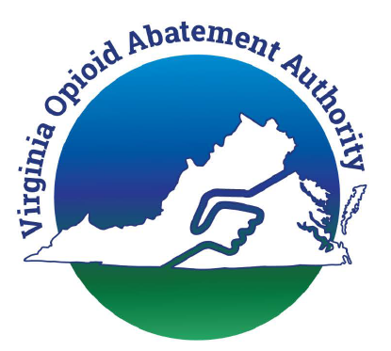








Substance Use Disorder Abatement (SUDA) Analytics Platform
Working with participating agencies to define use cases and validate data included.
Virginia Opioid Abatement Authority
Office of the Governor
Virginia Department of Behavioral Health & Developmental Services
York County Community Services
Virginia Department of Health
Virginia Department of Forensic Science
Virginia Department of Medical Assistance Services
Virginia State Police
Virginia Department of Corrections
Overdose Detection Mapping Application Program
Virginia Department of Health Professions

Slide 28



Substance Use Disorder Abatement (SUDA) Analytics Platform
Bringing together data from multiple Virginia agencies for decision ready insights.
Approach for Initial Release
Leverage Available Data
Build Solid Reporting Framework
Implement Tiered Governance
Key Activities
Engage Advisory Group to define use cases and metrics
Coordinate with Data Stewards and Data Owners for new data sharing agreements and data acquisition
Develop Power BI reports and SUDA portal
Review / test dashboard with key stakeholders to refine dashboard stories and validate data
Activate tiered approach to control user access to data
Notes:
High engagement, communication, and participation from agency leadership, data owners, and data stewards
Working with participating Agencies to tell the right stories and validate the included data for reporting accuracy
Bringing together data across agencies and exploring advanced analytics for decision ready insights

Slide 29
ODGA Events
Recent
Upcoming
ODGA Participation in COVITS
Lunch and Learns: Power BI Part 2, Unstructured Data Scanning Demo, Understanding VA’s Gov’t Data Collection and Dissemination Practices Act
Upcoming Lunch and Learns: Data for Executives, Visualizations best practices, Understanding the Virginia Data Collection and Dissemination Practices Act
Executive Data Board: Sept 23
Chris Burroughs VAGARA event- Oct 23
Data Stewards Group: Oct 22nd

Slide 30
Questions?

